Slide 1
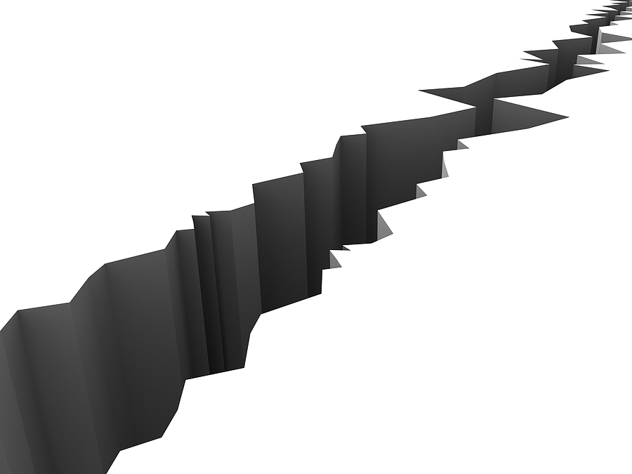
Measuring The Magnitude of Earthquakes
Project Group:
Sanskar Wavale (190100140)
Vishal Srivastava (19D110025)
Shridhar N
(190100113)

Slide 2
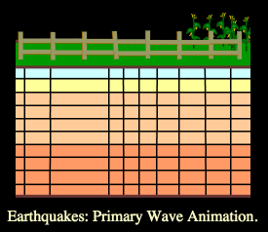
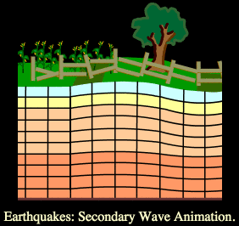
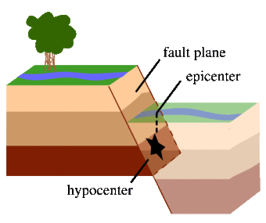
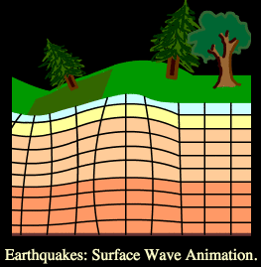
Science of Earthquakes:
An Earthquake is the result of a sudden release of energy in the earth’s crust that creates seismic waves.
Seismic waves are waves of energy that travel through Earth as a result of any natural or artificial phenomenon that causes a sudden release of energy such as earthquakes, nuclear explosion, etc. They are broadly of 2 types: (i) Body waves (P waves & S waves) (ii) Surface waves (Love waves & Rayleigh waves)

Slide 3
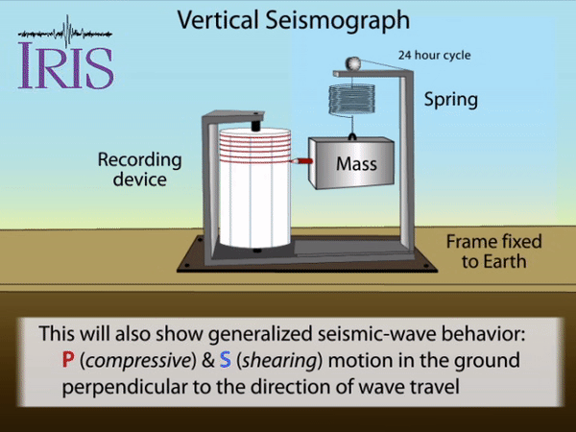
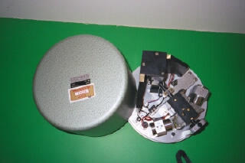
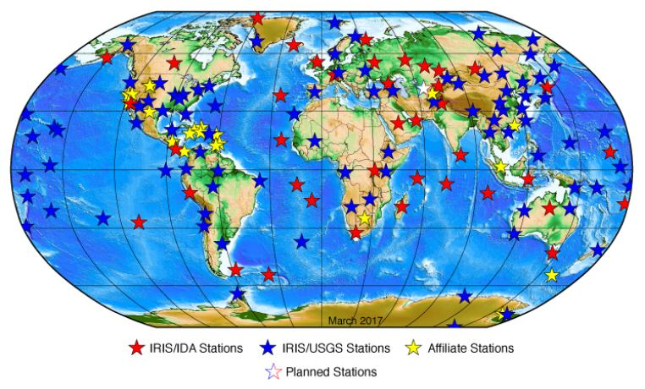
Seismograph:
A Seismograph is a device for measuring the movement of the earth, and consists of a ground-motion detection sensor, called a seismometer, coupled with a recording system.
Gutenberg-Richter magnitude-energy relation:
log E = 1.5×R + 4.8
STS-1
An electronic seismograph
Fun Fact: Seismographs have not only been used on earth but also on Moon to discover Moonquakes during the Apollo program in 1970s and on Mars aboard Insight lander to detect Marsquakes in 2019.

Slide 4
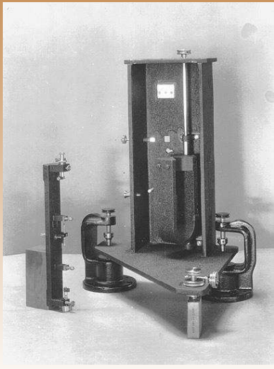
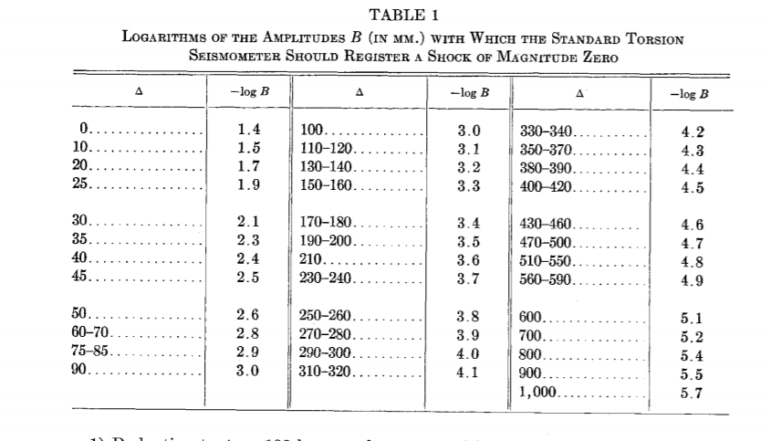
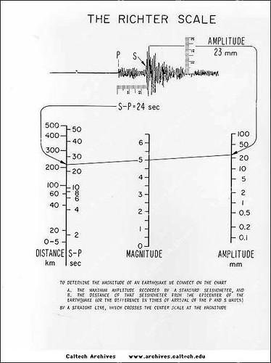
Richter Scale :
Richter (1935) defined the local magnitude ML of an earthquake observed at a station to be : ML = log A - log Ao ( ∆)
where A is the maximum amplitude in millimetres recorded on the Wood-Anderson Seismograph for an earthquake at epicentral distance of ∆ km,
Ao (∆ ) is the maximum amplitude at ∆ km for a standard earthquake.
Graphical procedure for estimating the Richter magnitude (ML)
Wood-Anderson Seismograph
-log Ao as a function of epicentral distance in Km

Slide 5
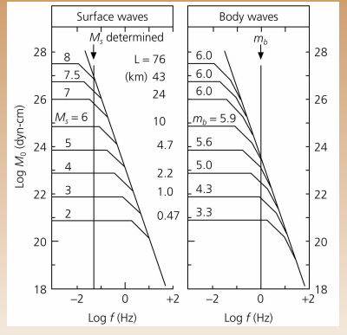
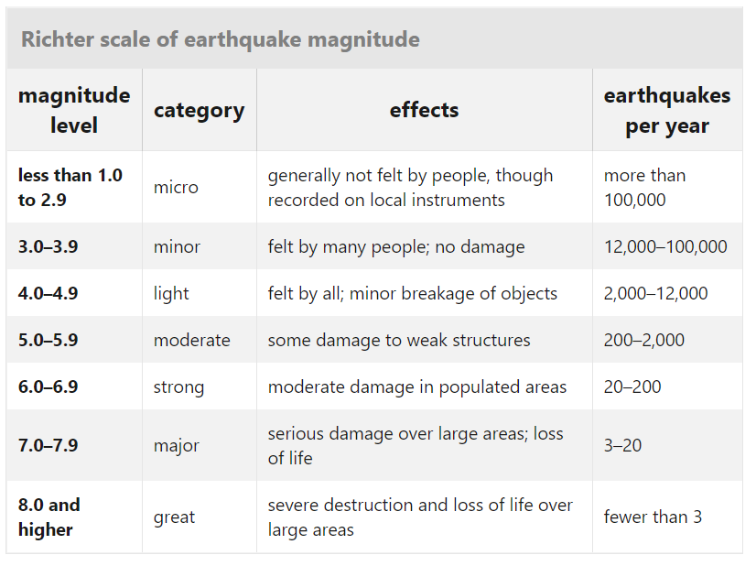
Limitations:
No direct mechanical basis for the definition of Richter magnitude.
Amplitudes depend on distance from the source, source depth, frequency and fault dimensions.
Only applies to Southern California and the Wood-Anderson seismograph.
For magnitudes greater than 6.5, the values calculated tend to cluster, or “saturate” near one another.
Other Scales :
Body-wave Magnitude (mb) Scale
Surface wave magnitude (Ms) Scale
Moment Magnitude (Mw) Scale
Duration Magnitude (Md) Scale
Fun Fact: Because of various shortcomings of the ML scale, Richter Scale is no longer used.
But much of the news media still refers to these as "Richter" magnitudes. All magnitude scales retain the logarithmic character of the original and are scaled to have roughly comparable numeric values.

Slide 6
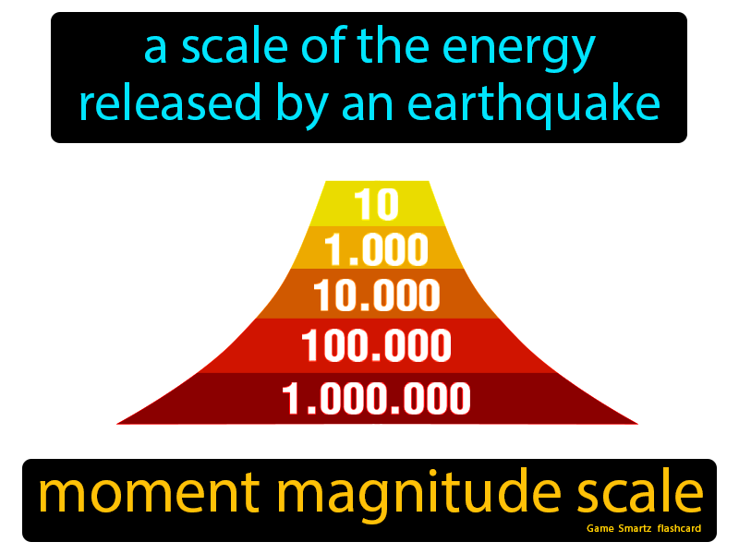
WHY MMS ?
Development of Richter scale was based on shallow-moderate sized earthquakes
At greater depths Richter Scale failed to measure since surface waves are insignificant
Body wave and Surface wave Magnitude Scale was developed after this but both had an issue of saturation
This created the need of a more efficient scale

Slide 7
Moment Magnitude Scale
THOMAS C. HANKS and HIROO KANAMORI
The basis of Seismic Moment (Mo) and its use in Moment Magnitude Scale
Shifting the basis of Magnitude scale to radiated energy by Hanks and Thatcher in 1972 and its benefits
Proposal of Moment Magnitude Scale by Hanks and Kanamori in 1979 and the background Maths involved
Mw = 2/3 log Mo - 10.7 .... (final equation)

Slide 8
Features of MMS
Consistent with previous scales such as M_{L}: 3-6, M_{S}: 5-8
Does not saturate at higher values with sound theoretical basis than other scales
Based on radiated energy but intrinsically Moment Magnitude Scale as defined by Hiroo Kanamori

Slide 9
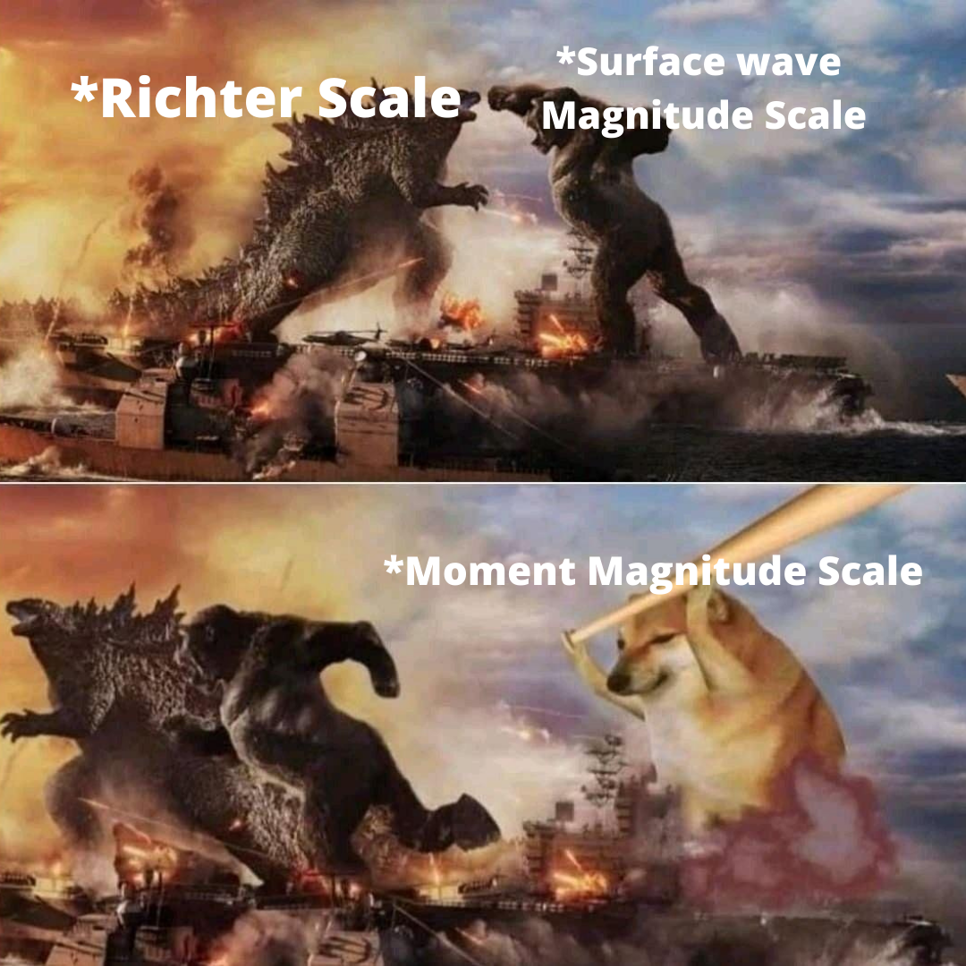
SO TO SUM UP !

